Slide 1
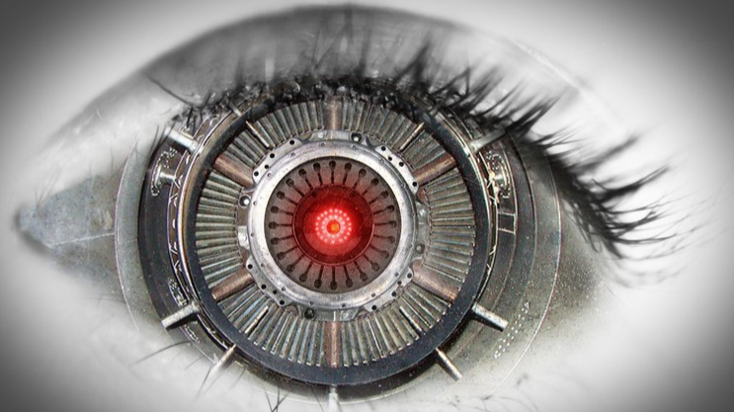
Topic: Application of Computer Vision for fruit detection and quality prediction
Presented by-Srinivas Mathur

Slide 2
Problem statement
To detect fruits(in this case litchi) in the image, count the number and classify each piece as fresh or defective.

Slide 3
Breakdown of the topics
The first part focuses on object detection using YOLO.
The second part focuses on use of transfer learning technique for spoilage detection.

Slide 4
Object detection (classification + localization)
Image classification involves predicting the class of one object in an image.
Object localization refers to identifying the location of one or more objects in an image and drawing a bounding box around their extent.
Object detection combines these two tasks and localizes and classifies one or more objects in an image.

Slide 5
Available object detection models
R-CNN(Regional Convolution neural networks) family - Accurate but slow .
YOLO (You Only Look Once)- fairly good but fast.

Slide 6
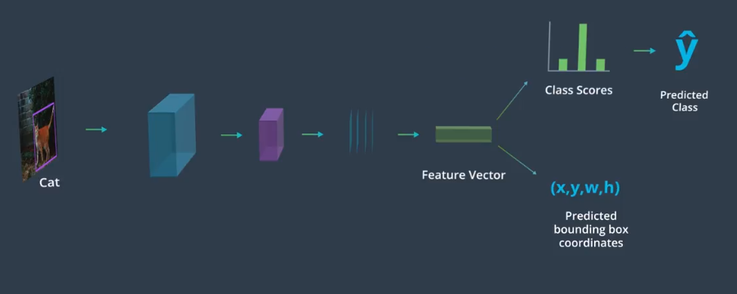
R-CNN Working

Slide 7
YOLO
A single neural network is applied to the full image. This network divides the image into regions or grids and predicts bounding boxes and probabilities for each region.
Now the same object can be detected by multiple bounding boxes.Therefore it uses non-maximal suppression to select best out of them.

Slide 8
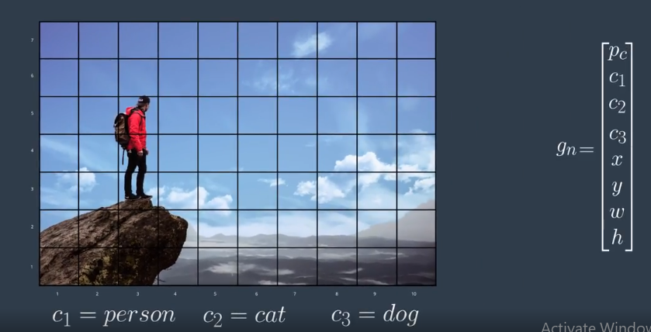

Slide 9
Transfer learning
Use of pre-trained state of the art models for predicting custom classes.
These models were trained on millions of images from imagenet to predict 1000 classes!
The weights of these models can be fine-tuned to predict any desired class.
Benefits - speeds up the training ,improves performance and works even with small number of images.

Slide 10
Various transfer learning models
Resnet50
VGG16
VGG19
Xception
Inception
Mobilenet

Slide 11
The model used for spoilage detection
VGG16 was selected for predicting the fresh pieces and defective pieces as it gave best results for the given training data.
Data augmentation was used to increase the no. of training images and avoid overfitting by slightly shifting, rotating and flipping the image.
Accuracy 85% on test set.

Slide 12
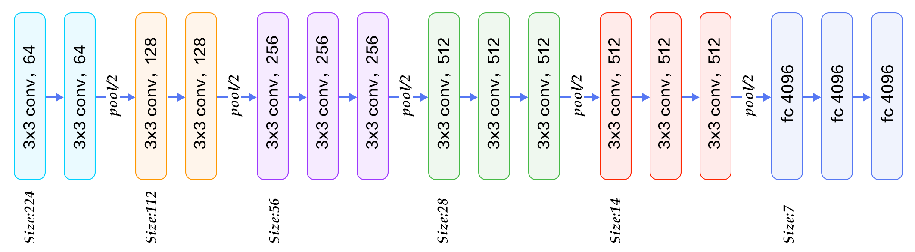
Architecture of VGG16

Slide 13
Workflow
The objects detected by yolo in the image were cropped and saved in an array.
Then these images were used to train the classification model.
While testing,again each object was saved in an array and prediction was made on each one of them.

Slide 14
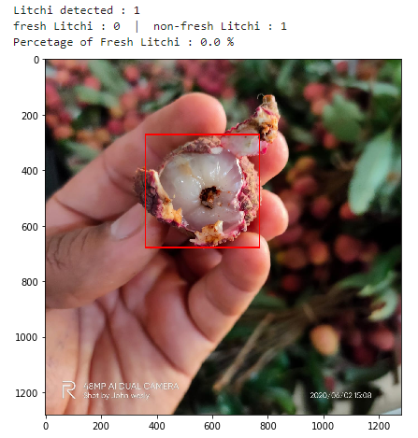
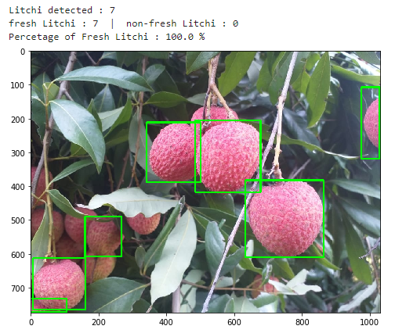
Results

Slide 15
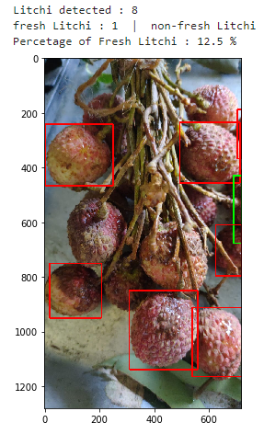
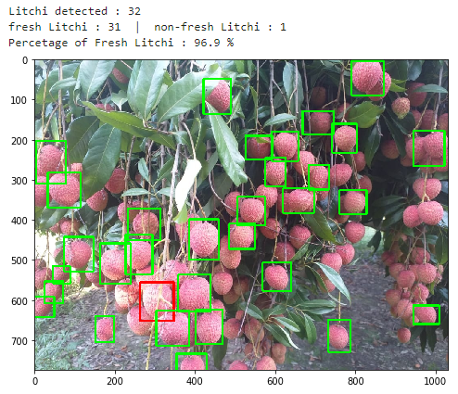

Slide 16
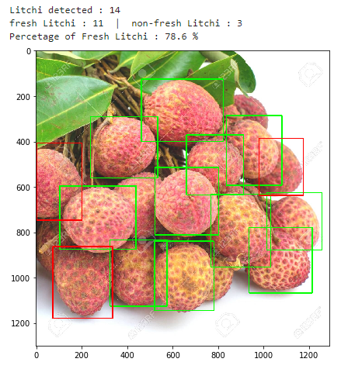
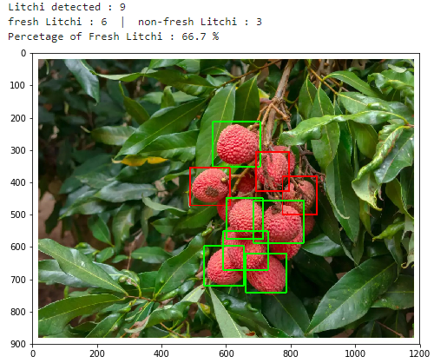

Slide 17
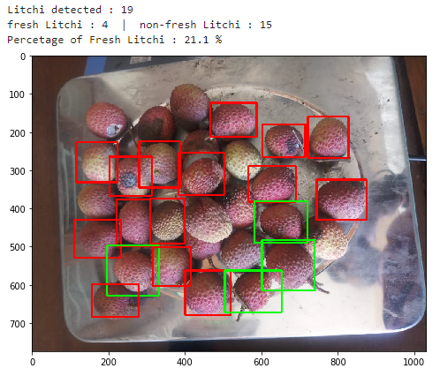
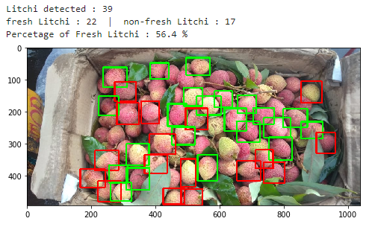

Slide 18
Improvements
More image data for predicting quality.
The images should be of high resolution and bright.
The probability value can be changed according to the use case.

Slide 19
Thank you

